Slide 1


DOCTORY AI
AI-Powered Early Medical Assessment for a Healthier Tomorrow

Slide 2
Problem We Address
  Millions of people struggle to access fast medical screening.
  Delays in diagnosis can lead to serious complications.
  Doctory AI offers an instant, AI-powered pre-check that supports patients before reaching a doctor.

Slide 3
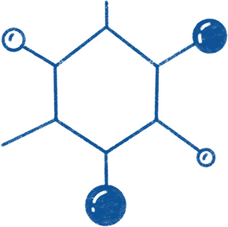
Project Overview
  Doctory AI is an intelligent platform that analyzes medical images and patient data to
  deliver quick, early health assessments.
  The system brings together deep-learning models and natural-language intelligence to
  make medical feedback simple, clear, and accessible.

Slide 4


Vision & Purpose
  Make early health screening available to everyone.
  Use AI to simplify complex medical information.
  Provide supportive, human-like explanations that patients can easily understand.
  Combine multiple medical tests into one unified platform.

Slide 5
What Our System Can Do
  Analyze chest X-rays for early signs of pneumonia.
  Detect malaria from microscopic images.
  Estimate diabetes & Heart Disease risks using patient records.
  Generate friendly, medical explanations using an LLM.
Everything works together as one seamless diagnostic experience.

Slide 6
How the System Works
  User uploads an image or enters medical data.
  AI models process the input and generate predictions.
  The system sends the results to an LLM.
  The LLM transforms them into clear, supportive feedback.
  The user receives an easy-to-understand medical summary.
We built Doctory AI step-by-step:
Data collection → Model training → System integration → Frontend development →LLM linking → Testing → Deployment.
https://doctory-pouhpcj3cmummjd5bis9m6.streamlit.app

Slide 7
Project Architecture
Tabular Prediction Models
Image Analysis Models
LLM Integration
Diabetes
  Uses a Voting Ensemble for prediction
Heart Disease
  Based on a Random Forest Classifier
Provide early insights and trends in user health
The LLM module
  Translates numeric predictions into medical explanations
  Adds clarity, empathy, and user-friendly interpretation
  Warns users when results suggest potential risk
  Ensures the system feels human and supportive
Pneumonia Model
  Based on YOLO Classification
Malaria Model
  Based on VGG Architecture

Slide 8
Key Features
Multi-modal analysis: images + tabular data.
Conversational explanations (chat-style).
Fast AI predictions powered by deep learning.
Lightweight HTML interface for smooth use.
Fully integrated backend and APIs.

Slide 9
Challenges We Overcame
01
03
Handling imbalanced medical datasets.
02
Improving predictions through iterative tuning.
Ensuring stable communication between models and APIs.

Slide 10

Future Potential
01
02
03
Mobile app version for easier access.
Expansion to more medical conditions.
Collaboration with healthcare professionals.

Slide 11

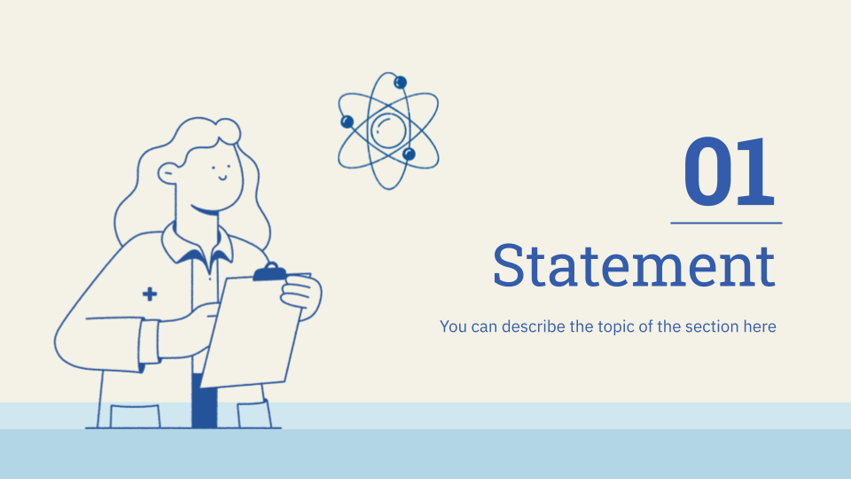

Doctory AI demonstrates how technology can support early health screening and empower
,patients with clear understandable insights
It’s a step toward more accessible, AI-driven healthcare
Thank You
´

